Slide 1
Promoting Employee Cleanliness and Hygiene at Workplace policies
Name
Institution
Date

Slide 2
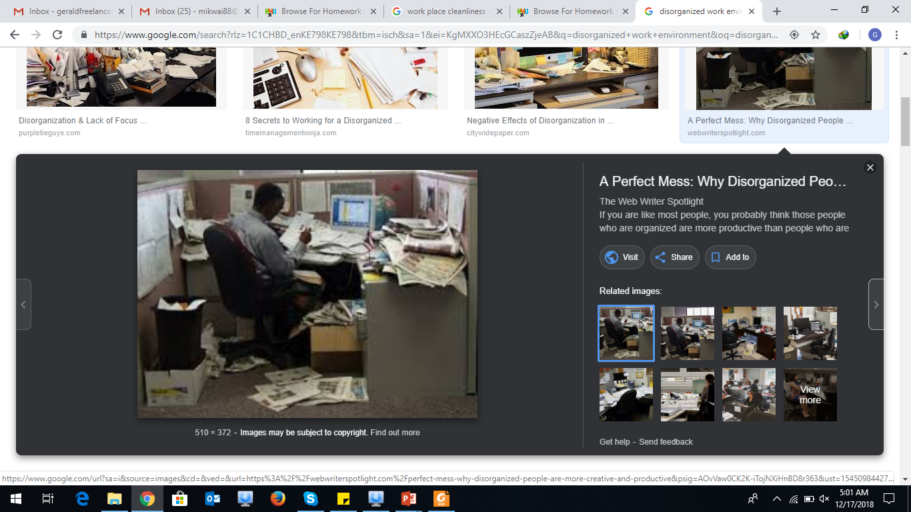
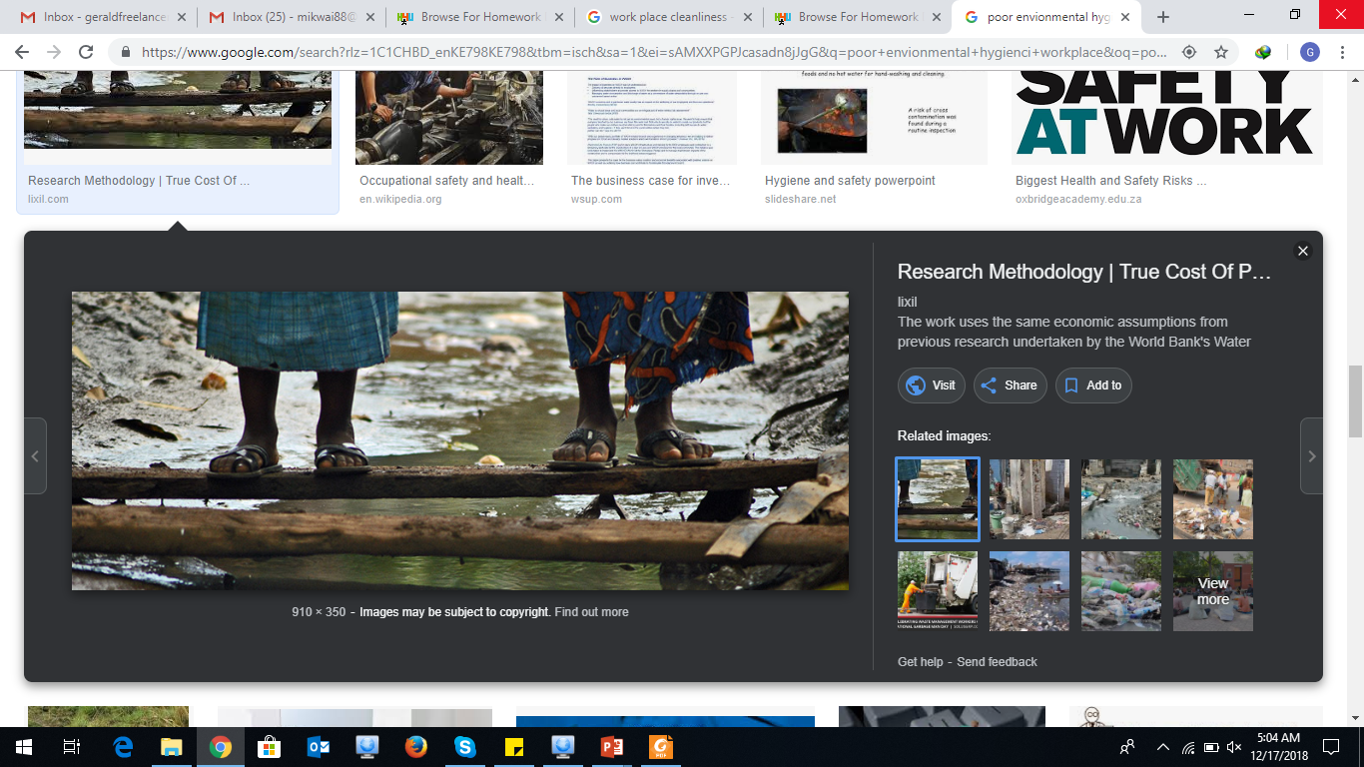
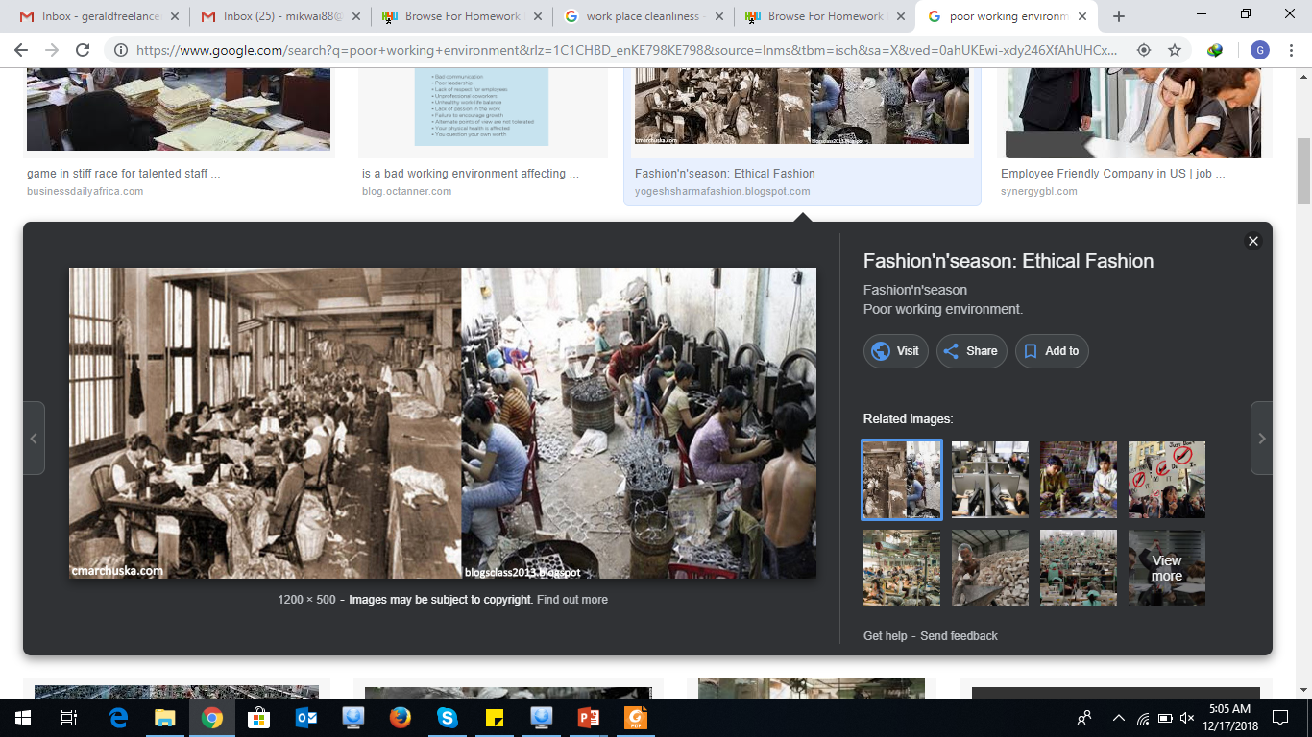
Poor Unhygienic conditions in work place
Some small and middle enterprises take little consideration on hygienic maintenance in their work place.
Such environmental unhygienic conditions would not only make your working environment unsafe but also would invite germs and diseases.

Slide 3
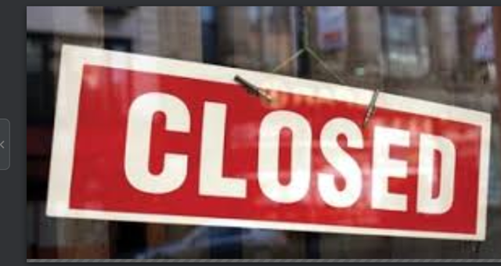
Policy alternatives
The local and national government should craft laws and regulations that bars business people from trading in poorly maintained work place.
Temporary closure would ensure that SMES take serious measures to maintain safe and hygienic working environment (Muralidharan, et al., 2015)
Avoid temporary closure due to hygienic conditions as it can result business closure.

Slide 4
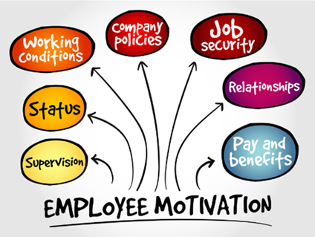
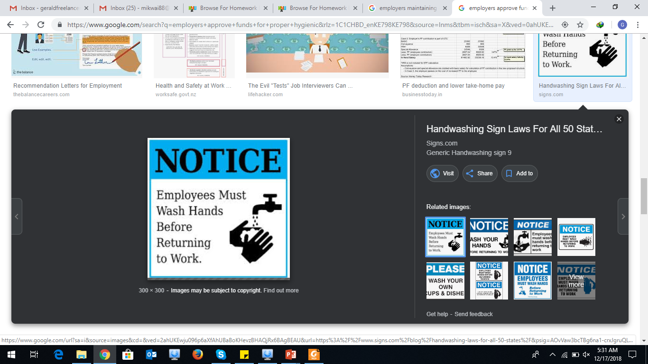
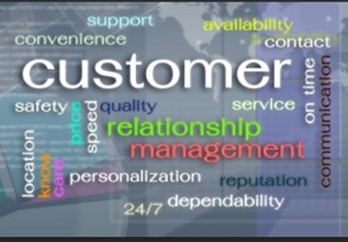
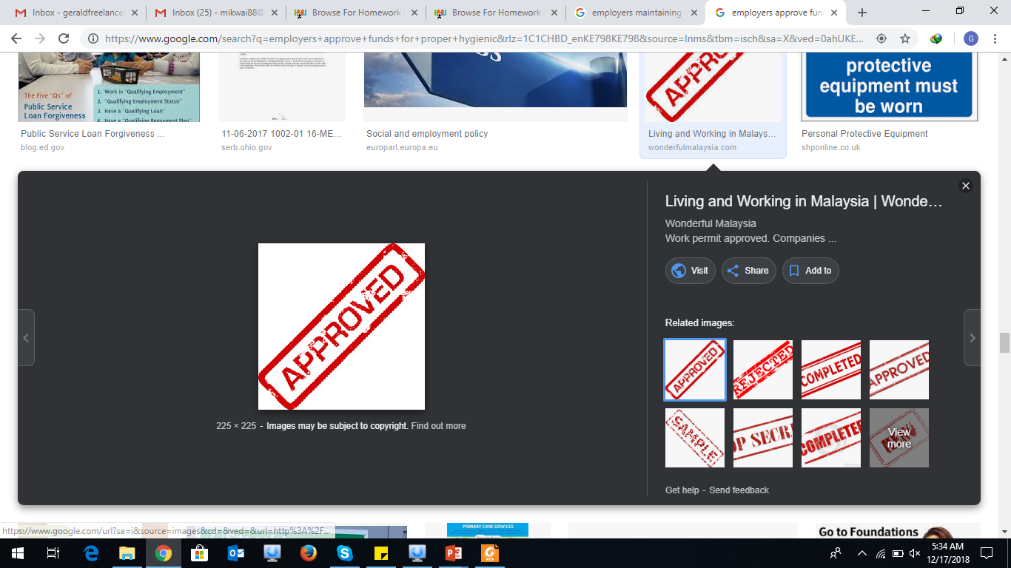
Major stakeholders and roles
The major stakeholders are;
Employees
Demand for funds to maintain hygienic and clean.
Employer
Approve funds to maintain hygienic conditions
Customers
Strike any business ties with poorly maintained hygienic work stations (Muralidharan, et al., 2015)

Slide 5
Budget factors
There is need to ensure that proper budgetary allocations are adhered as per the organizations ability to meet them.
A SMEP should not go for very expensive equipment's to maintain their work environment clean.

Slide 6
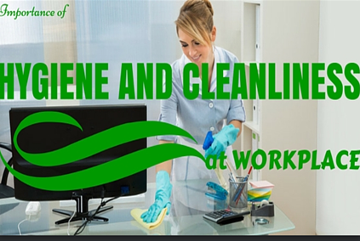
Saving measure
Outsource cleaning services from professional
Ensure that employees take care of work place environments
Embrace self responsibility among employees
Properly maintained workplace reduce on hygienic expenditures

Slide 7
Evaluative criteria
Manual criteria would be used in a bid to determine whether the workplace is hygienic or not.
The government agencies must send its team to inspect business organizations on hygienic conditions.

Slide 8
Incentives, subsidies, and support
Craft awards on the best maintained hygienic departments and individual employees in the organization
Seek subsidies from the government agencies particularly when undertaking corporate social responsibility.

Slide 9
Conclusion
The work place in an organization must be strictly adhere to the applicable environmental laws
Maintain cleanliness in the work place hence attract customers
Budget appropriate within organizational means.

Slide 10
Any questions ?

Slide 11
References
Muralidharan, A., Patil, H., & Patnaik, S. (2015). Unpacking the policy landscape for menstrual hygiene management: implications for school WASH programmes in India. Waterlines, 34(1), 79-91.
Storr, J., & Kilpatrick, C. (2012). Hand hygiene improvement in the community: a systems approach. British journal of community nursing, 17(Sup3), S24-S29.

